Slide 1

Capstone Project on Waste Management
Welcome to the world of waste management! Join us on a journey where we explore the challenges, solutions, and our proposed capstone project in this critical field.

Slide 2
Team Members & Roles
01
02
03
04
05
06
Gohil Jayvirsinh V
(PROJECT LEADER)
Patel Vraj J
(DATA EXPERT LOGBOOK)
Patel Krishang H
(INFORMATION REASERCHER)
CODER
Singh Abhishek
(DESIGNER/VIDEO PRODUCER)
Posia Kush V
(EXTRACTING DATA)
Patel Jay K
(COMMUNICATION LEADER)

Slide 3
What is Capstone Project
A capstone project is a project in which we must research a topic independently to find a deeper understanding of the subject matter.
We can integrate all our ai learning and demonstrate them through a comprehensive project in order to devise a innovative solution to a real world problem.

Slide 4
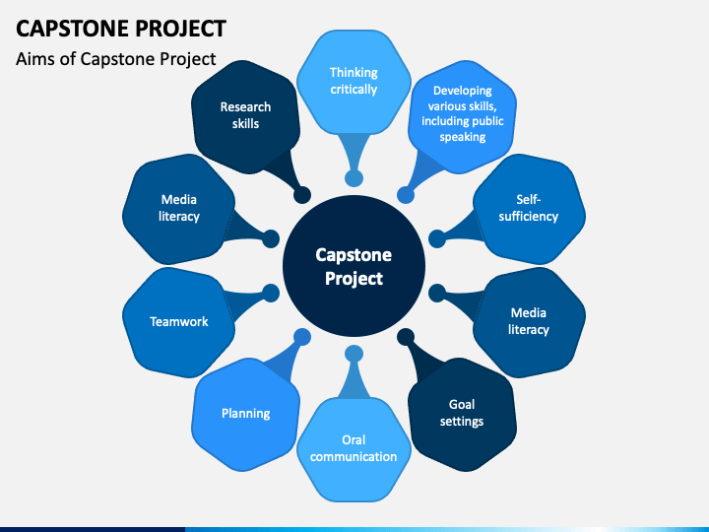
Steps of Capstone Project:

Slide 5

Introduction
Waste management is a pressing global issue that affects our environment, health, and resources. In this presentation, we delve into the complexities of waste management to shed light on its importance.

Slide 6
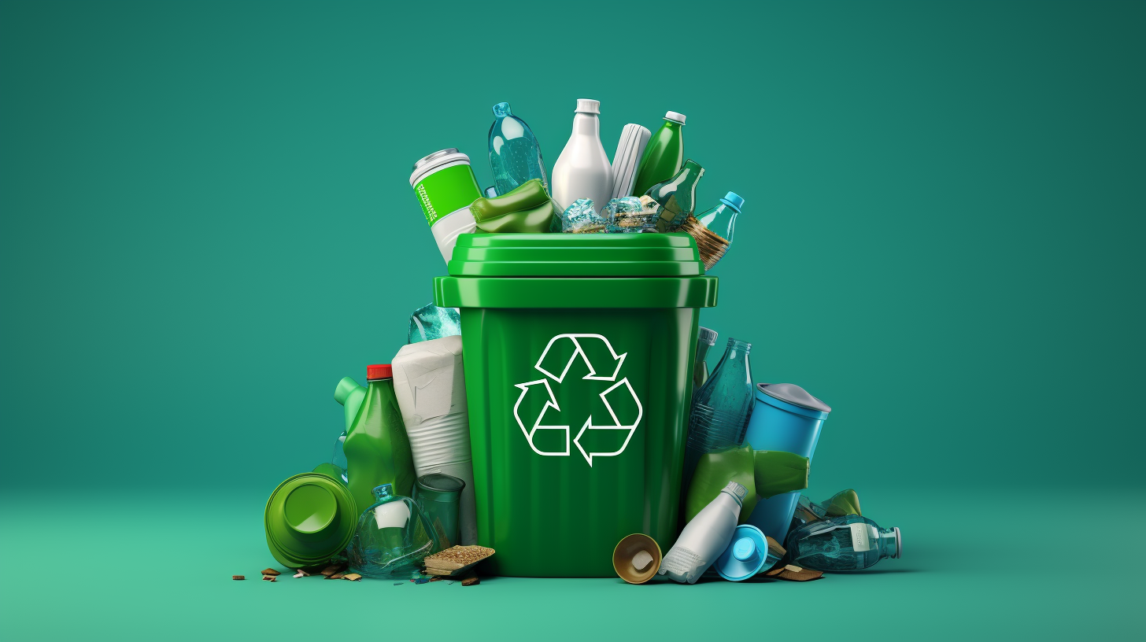
How can we help the people of India find a way to have a proper waste management system in every house so that they can come together to make up a clean and green India
Problem Definition

Slide 7
Challenges in Waste Management
Rapid Urbanization
Behavioral Change
Discuss how the rapid growth of cities adds immense pressure on waste management systems and explore potential solutions to manage urban waste sustainably.
.
Address the need for a shift in consumer habits and attitudes towards waste disposal, emphasizing the importance of education and awareness
Environmental Impacts
Inadequate Infrastructure
Highlight the challenges faced by regions with limited waste management infrastructure and showcase innovative approaches to bridge the gap.
.
Examine the consequences of improper waste management on ecosystems, wildlife, and climate change, highlighting the urgency for sustainable solutions.

Slide 8
Current solution
Waste Management Using AI:
Recycling Initiatives
Waste-to-Energy Conversion
Explore the latest advancements in recycling technologies and innovative programs that promote the efficient reuse of materials for a circular economy
Discover how waste can be transformed into valuable energy sources through methods such as anaerobic digestion and incineration with energy recovery.
You can develop an AI machine or a program that can help you work with the management of waste.

Slide 9
The Power of Waste Management Awareness
Imagine a world where every person is aware of the impact of their waste and the benefits of proper waste management. We would see a huge reduction in litter, pollution, and landfill waste. Recycling rates would skyrocket and waste-to-energy technologies would become more efficient. With everyone working together, we could create a cleaner, healthier planet for future generations.

Slide 10
Empathy Map
THINK
FEEL
I think imposing littering fines would be effective
I think adding environment-related courses in school
I feel like more campaigns should be made to raise awareness
I feel like action from society
SAY
DOES
Government should put information signs on streets and public places about the disadvantages of waste
I try to minimize the usage of waste in my household
I try to make recycling for waste and entertaining

Slide 11
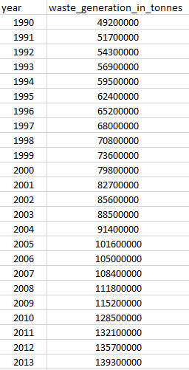
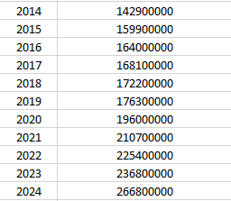
Dataset
The data provided represents the annual waste generation in tonnes for the year 1990 to 2024. Each entry consist of two values : the year and the corresponding amount of waste generate in tonnes. Here are the attributes of the dataset:
1)Year: The calendar year for which the waste generation data is recorded.
2)Waste generation (in tonnes): The amount of waste generated in metric tonnes for the respective year.
It is a time series dataset tracking the changes in waste generation over the years. The values in the “Waste Generation” Column indicate the total amount of waste generated globally or for a specific region in each corresponding year. The dataset shows an increasing trend over the years, suggesting a growth in waste generation

Slide 12

IMPORTS

Slide 13
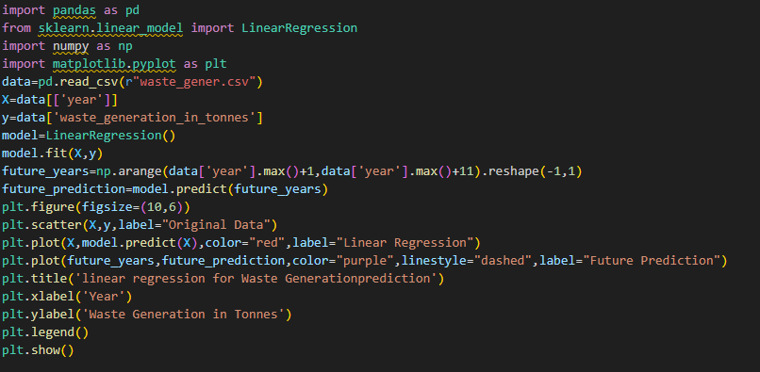
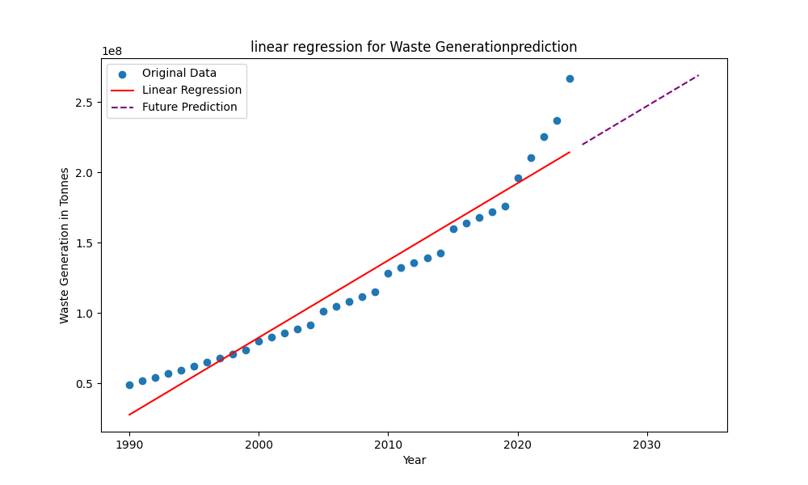
Linear Regression
The plot show that the Linear regression model fit the data well, with R-squared value of 0.95 .The future prediction show that waste generation is expected to continue to increasing in the coming years . The future prediction from the model show that waste generation in expect to continue to increase in the coming years.

Slide 14
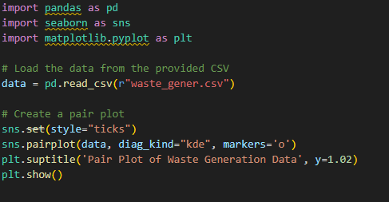
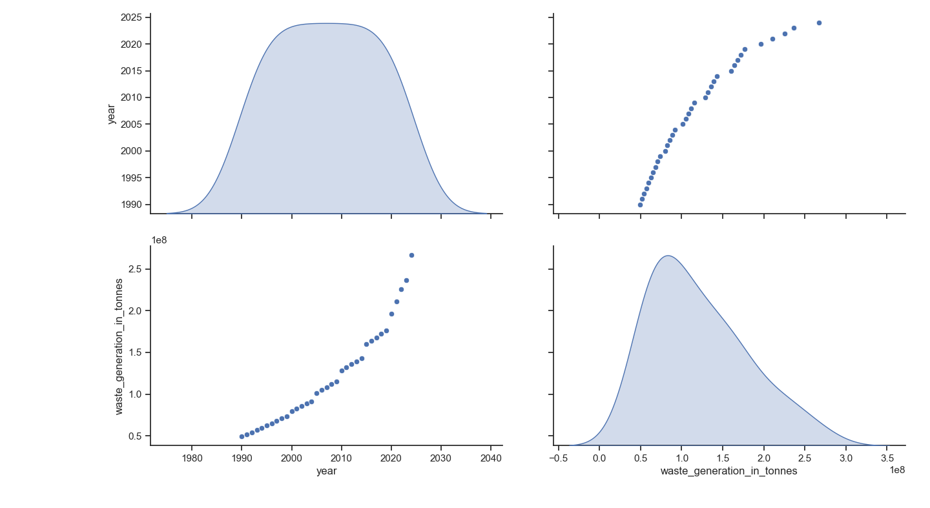
Pair Plot
The pair plot of the waste generation data that there is a strong positive correlation between the year and the waste generation in tonnes . This suggest that waste generation is increasing own time . The pair plot also shows that there is a moderate positive correlation between the GDP’s per capita and the waste generation in tonnes. This suggests that waste generation is also relate to economic development.

Slide 15
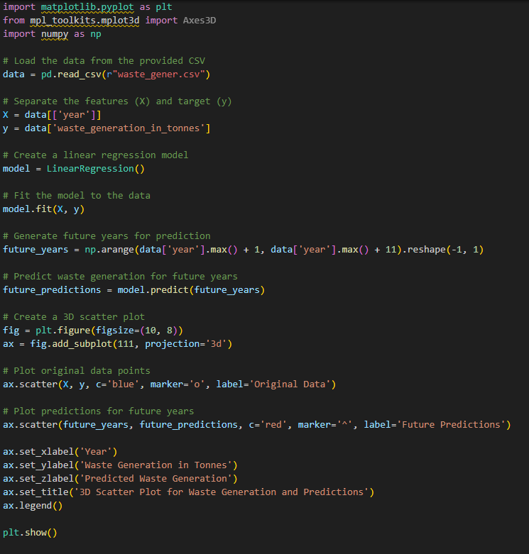
3-D Scatter Plot
The 3-D scatter plot provides a more comprehensive view of the data than a 2-D scatter plot . This because it allow us to see the relationship between waste generation year and predicative waste generation.

Slide 16
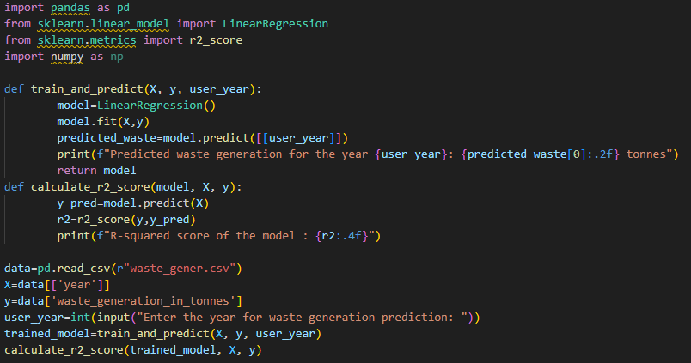
r2-Score
The R2 score, also known as the coefficient of determination, is a metric used to evaluate the performance of a regression model. It measures the proportion of the variance in the dependent variable that is predictable from the independent variables. The R2 score ranges from 1.0 (perfect prediction) to negative values (arbitrarily worse predictions)

Slide 17
Output of r2-score

Slide 18
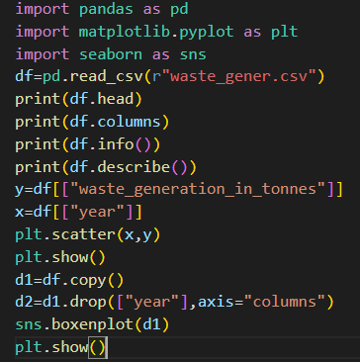
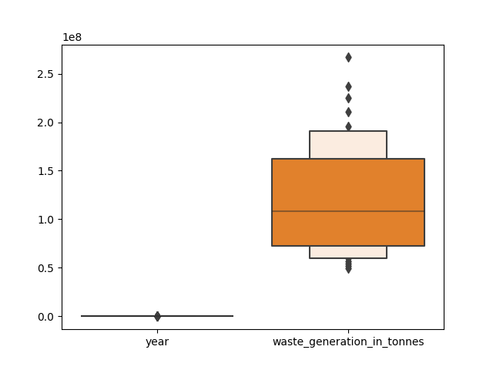
BOX PLOT
For the Creation of Box Plot. We have used the attribute “YEARS" to provide a visual summary of the data enabling us to quickly identify mean values, the dispersion of the data set, and signs of skewness.

Slide 19
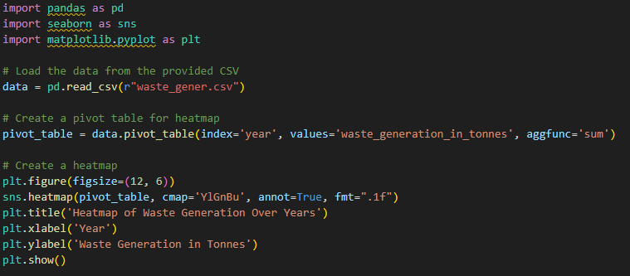
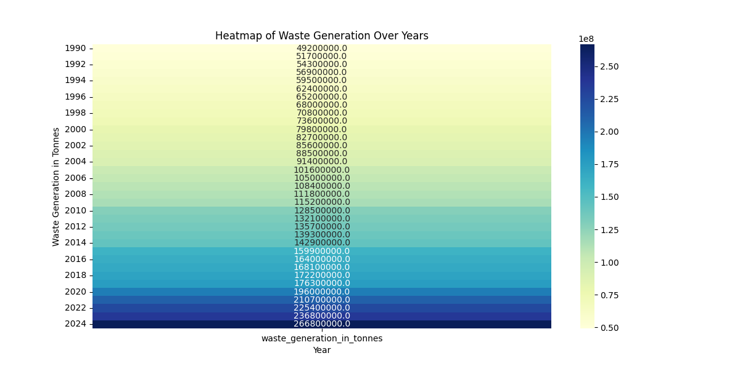
Heat Map
The heat map of the waste generation over the year show that waste generation has been increasing steadily over time . The darkest color on the heatmap also shows that there is some variation in waste generation from year to year. This could be due to number of factor , such as economic condition , weather patterns and changes in government policies.

Slide 20
Conclusion: Embracing a Sustainable Future
As we wrap up our exploration of waste management, it's clear that innovative solutions like chatbots are paving the way towards a greener future. By harnessing the power of technology and collective action, we can make a positive impact on our environment and create a more sustainable world for generations to come.

Slide 21
Thank You

